Slide 1
A Tutorial on How You Can Help The Human Race Find Our Next Home
Steven Cocke
Senior Data Analyst, Driven Brands
Josephine McDaniel
ScrumMaster, USAA
Andrew Wilkins
Naval Officer
Conor Nixon, Ph.D
Planetary Studies, NASA
John Santerre, Ph.D
Data Science Professor, SMU
Notes:
Hello everyone. My name is Josie and this is a tutorial on how you can help humanity find our next home. My teammates are Steven and Drew, and our sponsors are Dr. Nixon at NASA and Dr. Santerre from SMU.

Slide 2
Executive Summary
Topic
Results
Methodology for automating the classification of spectrally resolved observations of multiple emission lines
Our model was able to correctly classify 100% of previously discovered molecules in Titan’s atmosphere
Notes:
We are presenting a methodology for automating the classification of spectrally resolved observations of multiple emission lines. We applied a methodology to Titan’s atmosphere and were able to classify 100% of previously discovered molecules.

Slide 3
NASA’s Problem
Our Solution
To search for molecules
in a planetary atmosphere
it takes a lot of…
Automate the analysis of
possible molecules in any planet’s
atmosphere
Data Science
Manual effort
$$
Time
Notes:
I know that was a lot of words, but essentially what we were able to do was take NASA’s current manual process for identifying molecules in a planetary atmosphere, and automate it to save time and money.

Slide 4
“We’ve got 100 years to colonize another planet
…with climate change, overdue asteroid strikes,
epidemics and population growth,
our own planet is increasingly precarious”
-Stephen Hawking
Notes:
To help highlight the importance of our work, here is a quote from Stephen Hawking in which he estimates that we only have 100 years to colonize another planet based off of several attributes. Climate change, overdue asteroid strikes, and population growth to name a few.

Slide 5
Don’t Worry!
Utilizing the tools that we have developed will
EQUIP YOU
to help search the cosmos for Earth 2.0!
Notes:
But have no fear! Utilizing the tools that we have developed, you will be equipped to help humanity search the cosmos for Earth 2.0!

Slide 6
Recipe for Success
Understanding Spectroscopy
Data Collection
Data Preprocessing
A method (we’ve got you covered!)
Notes:
To search for habitable planets you’re going to need some background on spectroscopy, a way to collect data, perform some data preprocessing, and then a method to analyze the data – which we have got you covered on!

Slide 7
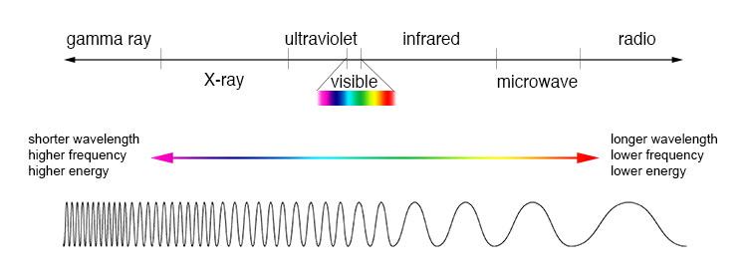
Understanding Spectroscopy
Frequency (Hz) – number of waves that pass a point in space during a time interval
Intensity (cd) – refers to the strength or amount of light produced by a specific source
Flux (lm) – is the measure of the perceived power of light
Notes:
There is a lot to know about spectroscopy, some of which I am sure you are already familiar with, however, the main terms that are important for our work are frequency, intensity, and flux.

Slide 8
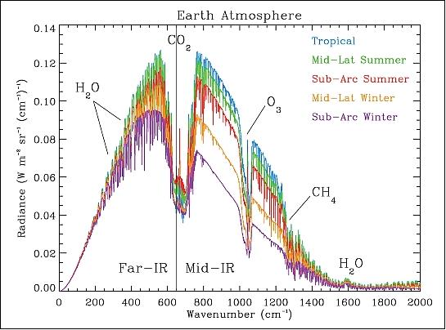
Understanding Spectroscopy
Notes:
Essentially, light hits a planet’s atmosphere, where molecules absorb a specific amount and reflect a specific amount of the light at different Essentially, a molecule in an atmosphere reflects a certain amount of light at different frequencies. The way in which it does so, is unique to each molecule, just like a fingerprint is unique to a person.

Slide 9
Data Collection
Notes:
For our project, the data was collected via the Atacama Large Millimeter/submillimeter Array telescope, or ALMA for short. It is located in Antofagasta, Chile.

Slide 10
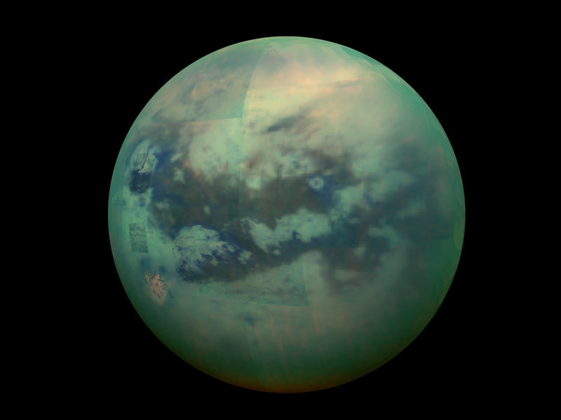
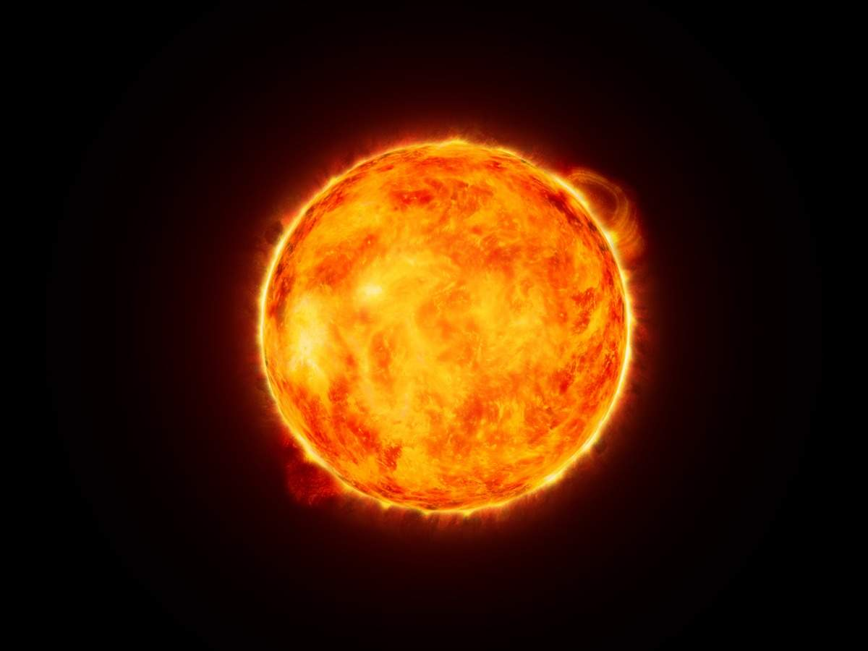
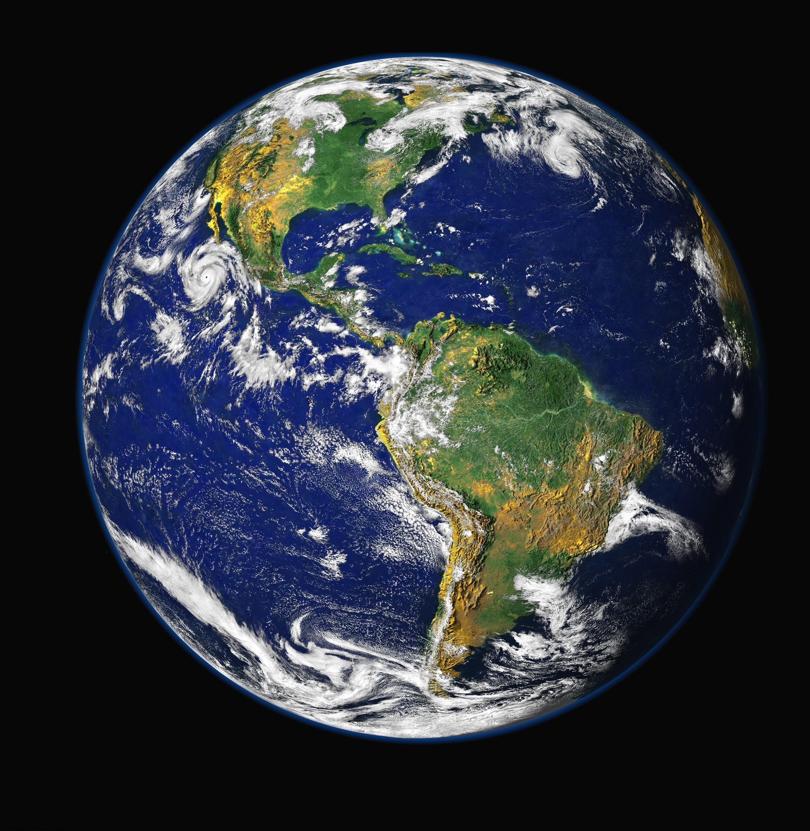
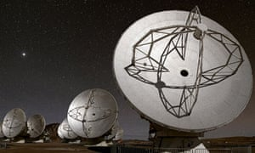

Recap
Light
Molecules Absorb/Reflect
ALMA
Telescope
Raw Data
Notes:
To recap, light from a star reflects off of a planetary atmosphere and is then seen through a telescope. This process produces raw data.

Slide 11
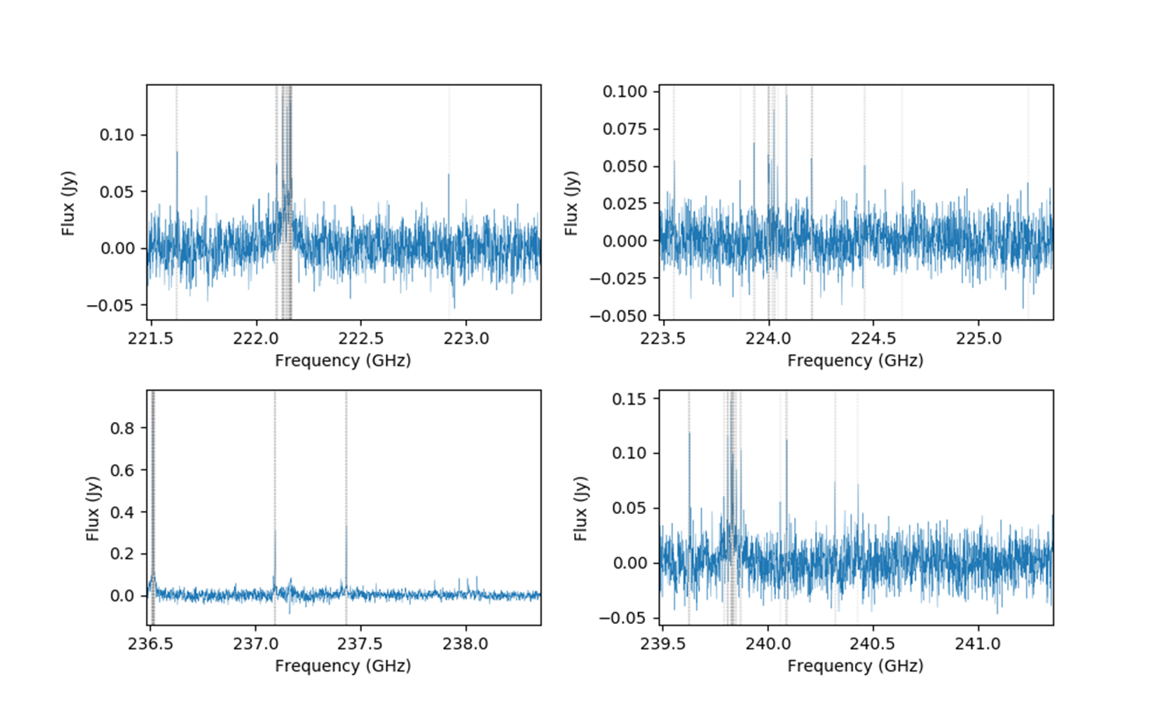
Data Collection
Titan’s Atmosphere
Notes:
To better visualize this process, here is an example of the data we used from Titan’s atmosphere, which is one of Saturn’s moons and the planetary body we applied our processes to. The tall spikes in the data represent possible reflections from molecules.

Slide 12

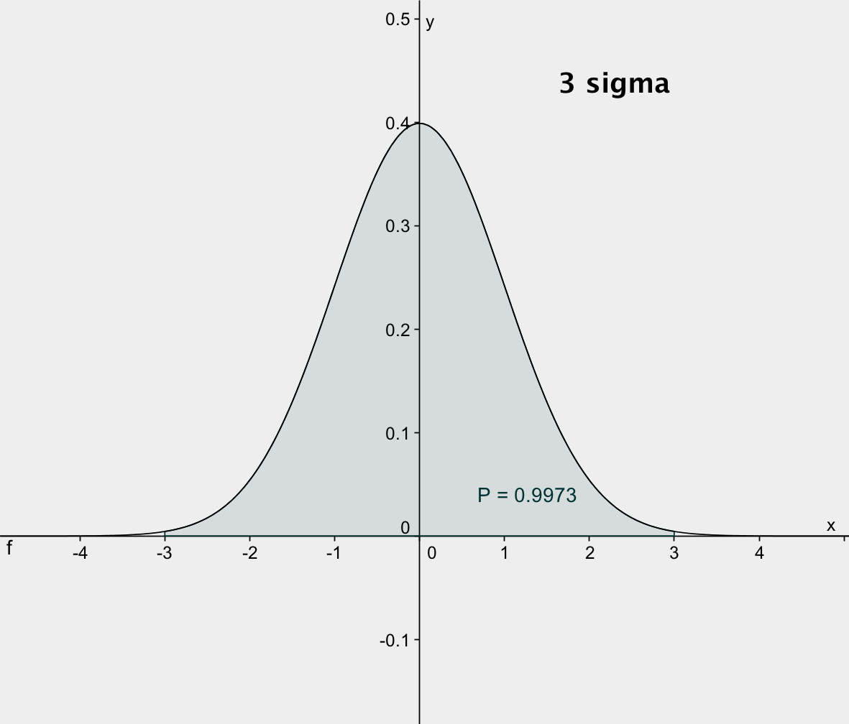


Data Collection
3 Sigma Spikes
In Frequency
Splatalogue
List of Possible
Molecules
List of Possible
Molecules
Molecule Tags
JPL/CDMS
All Known Spectral Lines
For Each Molecule of Interest
Notes:
Once the data has been collected, we look for the frequencies associated with spikes three standard deviations away from the mean. We pass these frequencies through databases, such as Splatalogue and the Jet Propulsion Laboratory, to retrieve all molecules that could possibly contribute to each spike in our data.

Slide 13
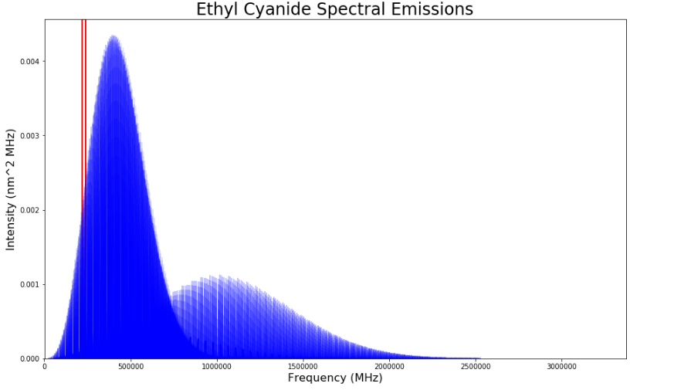
Data Collection
Notes:
This is an example of the spectral lines retrieved back for Ethyl Cyanide, where the small sliver of red is our window of data from the ALMA telescope, and the rest are the millions of known spectral lines that span all frequencies from the databases.

Slide 14

Recap
Light
Molecules Absorb/Reflect Light
Data Enrichment
ALMA
Telescope
Raw Data
JPL
???
CDMS
Splatalogue
Notes:
Updating our roadmap, the raw data is sent to databases and the data is enriched to include all the spectral lines for possible molecules in the planet’s atmosphere. Here I will hand it over to Drew to discuss the method behind analyzing the data.

Slide 15
Data Preprocessing
Sort the entries by intensity
Strongest emission frequencies first
Weakest emission frequencies last
Match closest binned frequencies
CDMS/JPL frequencies differ from input data
Find the frequency bin closest to CDMS/JPL data
Determine if a “spike” is present
Spikes found at or above 3σ away from mean flux
3σ dependent on which file the data came from
Notes:
Thanks Steven. Now that we’ve collected all the data we need, the next step is to figure out which emission lines are strongest for each molecule, and match up their catalogued frequencies with the closest frequency bin from the input data. Once we know the frequency in the input data that each emission line is closest to, we can determine if that molecule may be responsible for a 3 sigma spike.

Slide 16
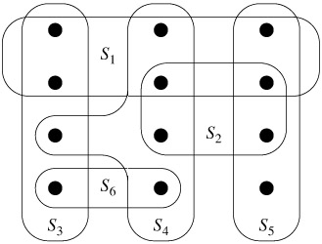
Method: Set-Cover Algorithm
Universe
Set
Cover
We’re interested in the lowest-cost cover of sets that returns the Universe
The “Universe” is all 3σ frequencies in the input data
Each “Set” is all 3σ frequencies for a possible molecule
Notes:
Now, the data is in a format for our algorithm to do all the heavy lifting. The first thing it does is identify a set of molecules that can reproduce the spike signatures found in the input data by implementing a greedy set cover algorithm.

Slide 17

Method: Evaluation Metric Creation
Frequency
Intensity
Flux
Weighted Result
Notes:
Once a set of probable molecules has been identified, our algorithm performs some calculations to weight the likelihood of each molecule in the set cover as being present or not present. As long as the weight meets the threshold criteria set by you, the molecule is classified as present.

Slide 18

Recap
Light
Molecules Absorb/Reflect Light
Set-Cover Algorithm
ALMA
Telescope
Data Enrichment
Data Prep
Raw Data
JPL
CDMS
Most
Probable
Molecule
Combination
Splatalogue
18
Notes:
Our full roadmap is displayed here. We identify a list of possible molecules using a set-cover algorithm, and then implement 2 different selection metrics to classify the molecules in the set cover as present or not present.

Slide 19
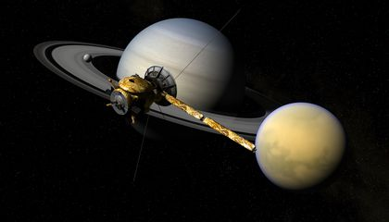
Example Results: Titan
NASA Known Molecules
Our Results
Cyanoacetylene
Methyl Cyanide
Ethyl Cyanide
Methyl Acetylene
???
Cyanoacetylene
Methyl Cyanide
Ethyl Cyanide
Methyl Acetylene
Formaldehyde
Notes:
The molecules we classified as present using the better of the two selection methods are displayed above. Our results line up perfectly with what has already been identified by NASA in this data set, and even identified one possible new molecule for further research.

Slide 20
Project Outcome
1. “Plug n’ Play” Jupyter Notebook
2. NASA cost savings of $8,000 per spectra fitted
3. Custom API
4. Potential Molecules in a Planetary Atmosphere!
Notes:
The outcome of our project can be seen on the left: a plug n’ play jupyter notebook, an $8,000 cost savings and 80 man-hours savings to NASA, a custom API to retrieve enriched data from the underlying databases, and an accurate list of potential molecules on a planetary atmosphere. So what are you waiting for? Go out there and find New Earth!

